Slide 1

Memory Management
PASS
CS532: OS Foundations
Lab Assignment
Mail id: faiyaz@pdx.edu
Partner’s mail id: boyapati@pdx.edu

Slide 2
Instructions: Make a copy of this document, move your copy to your submissions folder and fill the document with your responses. Use the space on each slide to show your responses, and add additional slides as needed.
When ready for grading: complete the lab assignment submission form and include a link to your filled document

Slide 3
Linux utilities: free and pmap
For this assignment you will need to use a Linux system such as babbage.cs.pdx.edu so that you can run the tools free and pmap.
When logged into babbage.cs.pdx.edu use the man command to learn about these tools. Specifically, run these commands and study the output:
man 1 free
man 1 pmap
You will only need a few of the many features provided by these tools.

Slide 4
1. Use free to answer these questions:
A. How much memory is in your system (in gigabytes)?
Answer: 67Gi
B. How much is free?
Answer: 50Gi
C. Do these numbers match your intuition?
Answer: No

Slide 5
2. Write, compile and run a C program (call it cs532-memory-user.c) that uses a known amount of memory. This program should take one command line argument: the number of megabytes of memory to allocate. When run, it should allocate an array of this size and repeatedly iterate through the array, touching each entry. The program should do this indefinitely until the user stops it with Ctrl-C.
Add a new slide (or multiple) showing your code. Or copy your code to your submissions folder and include a link to it <HERE>.
https://drive.google.com/file/d/1uyEOxOBaPQ7r5QfCR_h3yS9PhkGtb3vF/view?usp=sharing

Slide 6
3. Now, while running your cs532-memory-user program, also (in a different terminal window, but on the same machine) run the free tool.
A. How do the memory usage totals change when your program is running?
Answer: The free is goes on decreasing when the programming is running with an input.
B. How about when you terminate the cs532-memory-user program? Do the numbers match your expectations?
Answer: When I terminated the program cs532-memory-user with the help of ctrl+c, the memory is returned back. Yes, the numbers matches my expectation.

Slide 7
C. Fill the following table using your cs532-memory-user program and the free utility. Record the amount of free memory (in megabytes) before, during and after running cs532-memory-user utilizing each corresponding amount of memory.
 | before | during | after
10 MB | 42230 | 42132 | 42231
100 MB | 42145 | 42128 | 42239
1 GB | 42228 | 41115 | 42232
10 GB | 56021 | 45666 | 55922
100 GB | 42138 | Memory allocation failed | N/A

Slide 8
To use pmap, you must know the ID of the process to monitor. So, first run your cs532-memory-user program in one terminal window (ask it to allocate 100 megabytes). Then, in a separate terminal window, run ps auxw to see a list of all processes. Within that list, find your running cs532-memory-user program and its pid.
Use pmap to print out the memory map of your cs532-memory-user program.

Slide 9
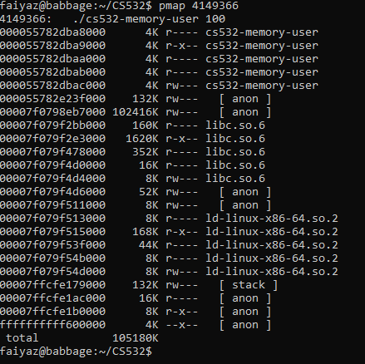
4. Copy and paste a screen capture of the first 10 lines of your pmap output.

Slide 10
5.
A. How many mappings make up the process map for your cs532-memory-user program?
B. What is the smallest size of any mapping shown by pmap?
Answer: It took 23.
Answer: The smallest was 4k.

Slide 11
C. List the 5 largest mappings along with their sizes.
Mapping name | Size (in kilobytes, as reported by pmap)
[ anon ] | 102416K
libc.so.6 | 1620K
libc.so.6 | 352K
ld-linux-x86-64.so.2 | 168K
[stack] | 132K

